Slide 1
Secure data hiding in image using steganography
CAPSTONE PROJECT
Presented By: Ajay Kumar Sharma (AICTE Id - STU671af2cddd7221729819341 )
Student Name : Ajay Kumar Sharma
College Name & Department : Vikrant Group Of Institutions ( RGPV )
Computer Science And Engineering

Slide 2
OUTLINE
Problem Statement
Technology used
Wow factor
End users
Result
Conclusion
Git-hub Link
Future scope

Slide 3
Problem Statement
In the digital Era , Secure communication is crucial to protect sensitive information from cyber threats. Traditional encryption methods, while effective, often attract attention and can be intercepted. Steganography offers a discreet solution by embedding data within images, making it invisible to unauthorized users. This project focuses on implementing Image-based steganography using Python, ensuring secure data transmission without altering the image’s appearance. The goal is to enhance privacy and prevent unauthorized access to confidential information.

Slide 4
Technology used
Libraries Used -
OpenCV (cv2) - Used for reading and modifying image pixels to embed and extract hidden data.
OS - Helps with file handling, such as opening the encrypted image after processing.
String - Used for mapping characters to their corresponding ASCII values for encoding and decoding.
Platforms Used -
Python 3.13.2 - The programming language used for implementing steganography.
PIP 25.0.1 - Package manager used for installing dependencies.
Visual Studio Code (VS Code) - IDE used for writing and testing the code.
Windows OS - Platform where the project is executed and tested

Slide 5
Wow factors
Invisible Data Embedding - The hidden message is seamlessly concealed within an image without altering its visual appearance.
Secure Passcode Protection - Only users with the correct passcode can decrypt and retrieve the hidden data, ensuring privacy and security.
Lightweight & Fast Processing - The project uses efficient pixel manipulation, making it quick and resource-friendly without requiring heavy cryptographic libraries.
Stealthy Communication - Unlike traditional encryption methods, steganography does not raise suspicion, making it ideal for covert messaging and secure data transfer.
Minimal Image Distortion - The image remains unchanged to the human eye, ensuring that the hidden data does not compromise the quality of the image.
Real-World Applications - Can be used in cybersecurity, government intelligence, private messaging, and digital watermarking to prevent unauthorized access.

Slide 6
End users
Cybersecurity Professionals - Used for secure communication and preventing unauthorized data access.
Government & Defense Agencies - Helps in confidential information exchange and secure intelligence communication.
Journalists & Activists - Enables safe transmission of sensitive data in regions with restricted press freedom.
Private Messaging & Businesses - Useful for companies needing secure internal communication and digital watermarking.
Financial Institutions - Can be applied for secure banking transactions and data protection against cyber fraud.
Researchers & Developers - Helps in advancing steganographic techniques for future cybersecurity innovations.

Slide 7
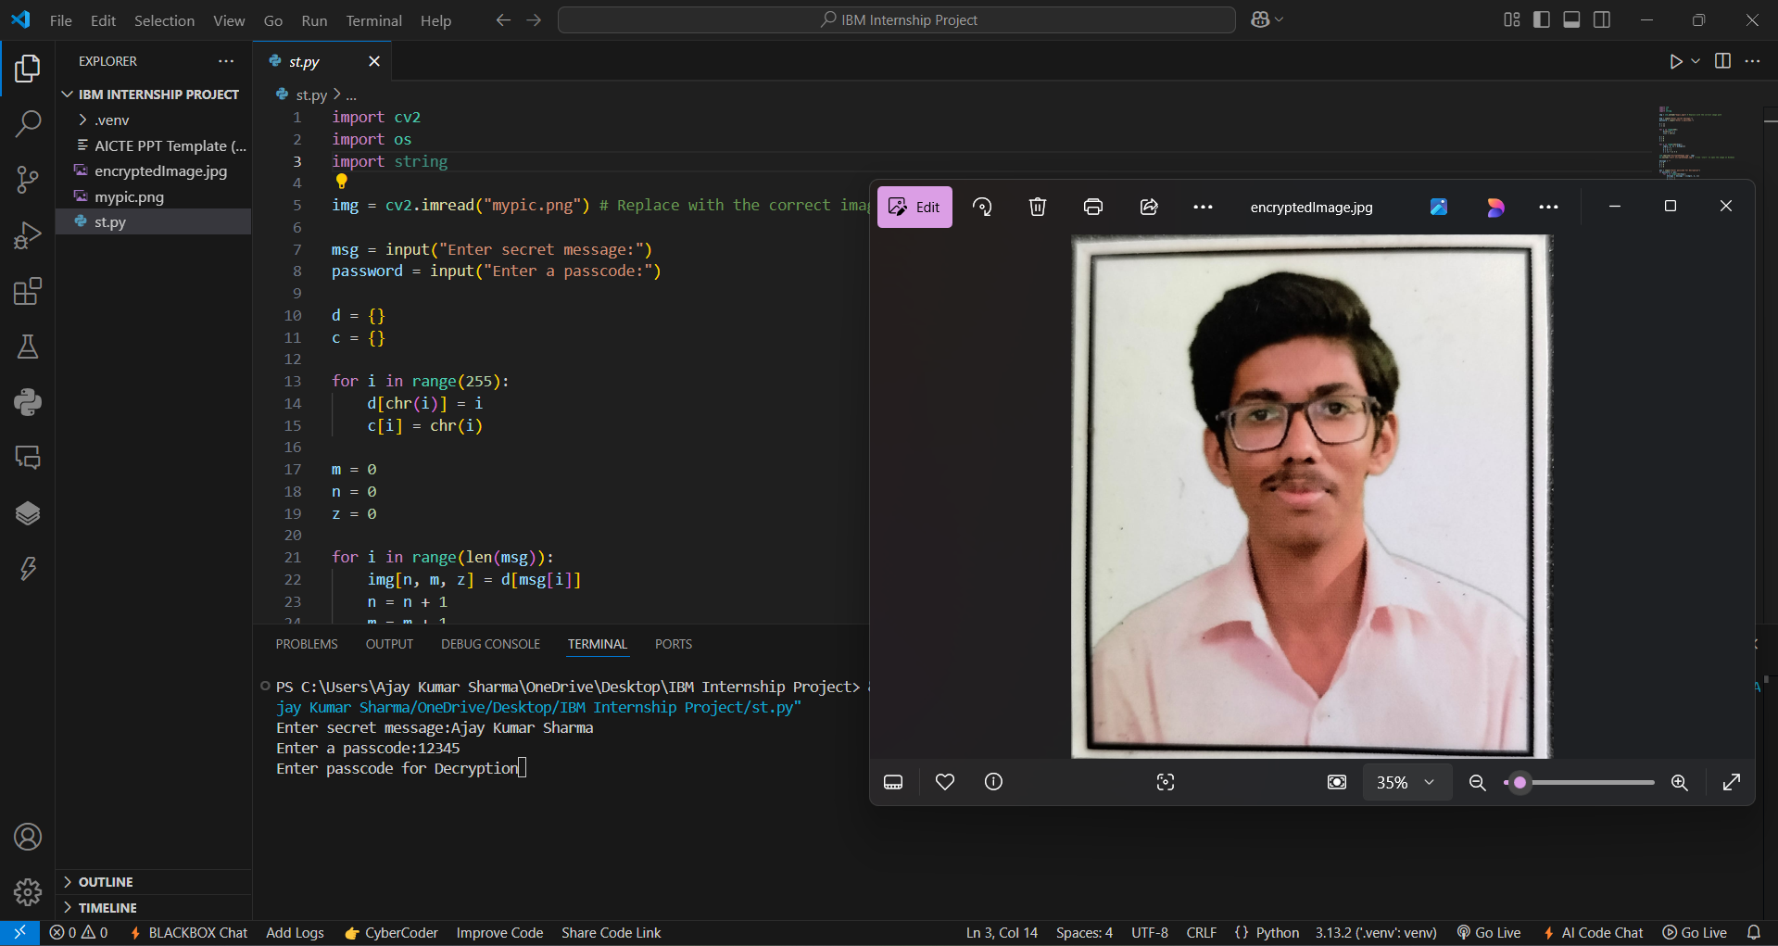
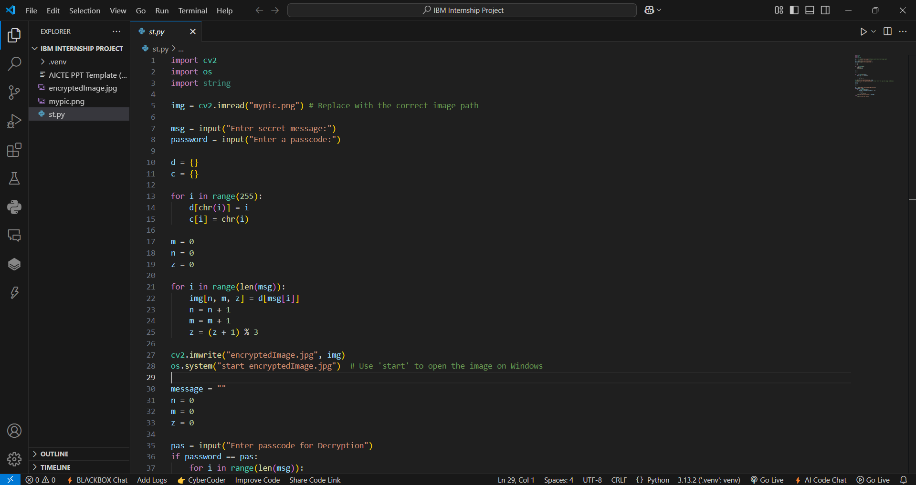
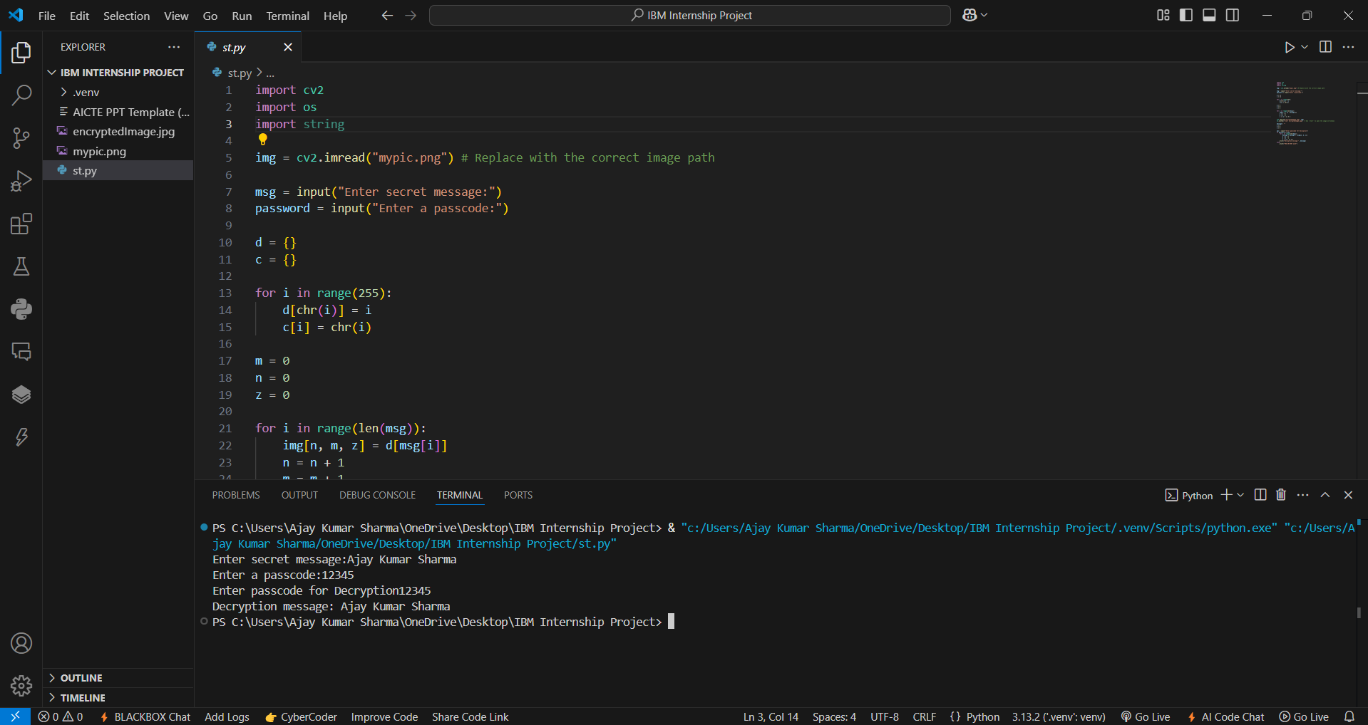
Results
This is the core Python code used to implement
image-based steganography, enabling secure data hiding
and retrieval. Below are the three main screenshots
demonstrating the process –
1️⃣ Main Code Implementation – The Python script
responsible for embedding and extracting hidden data. 2️⃣ Encryption Process – Entering a secret message and password to securely hide data within an image. 3️⃣ Decryption Process – Retrieving the hidden message from the image using the correct password.

Slide 8
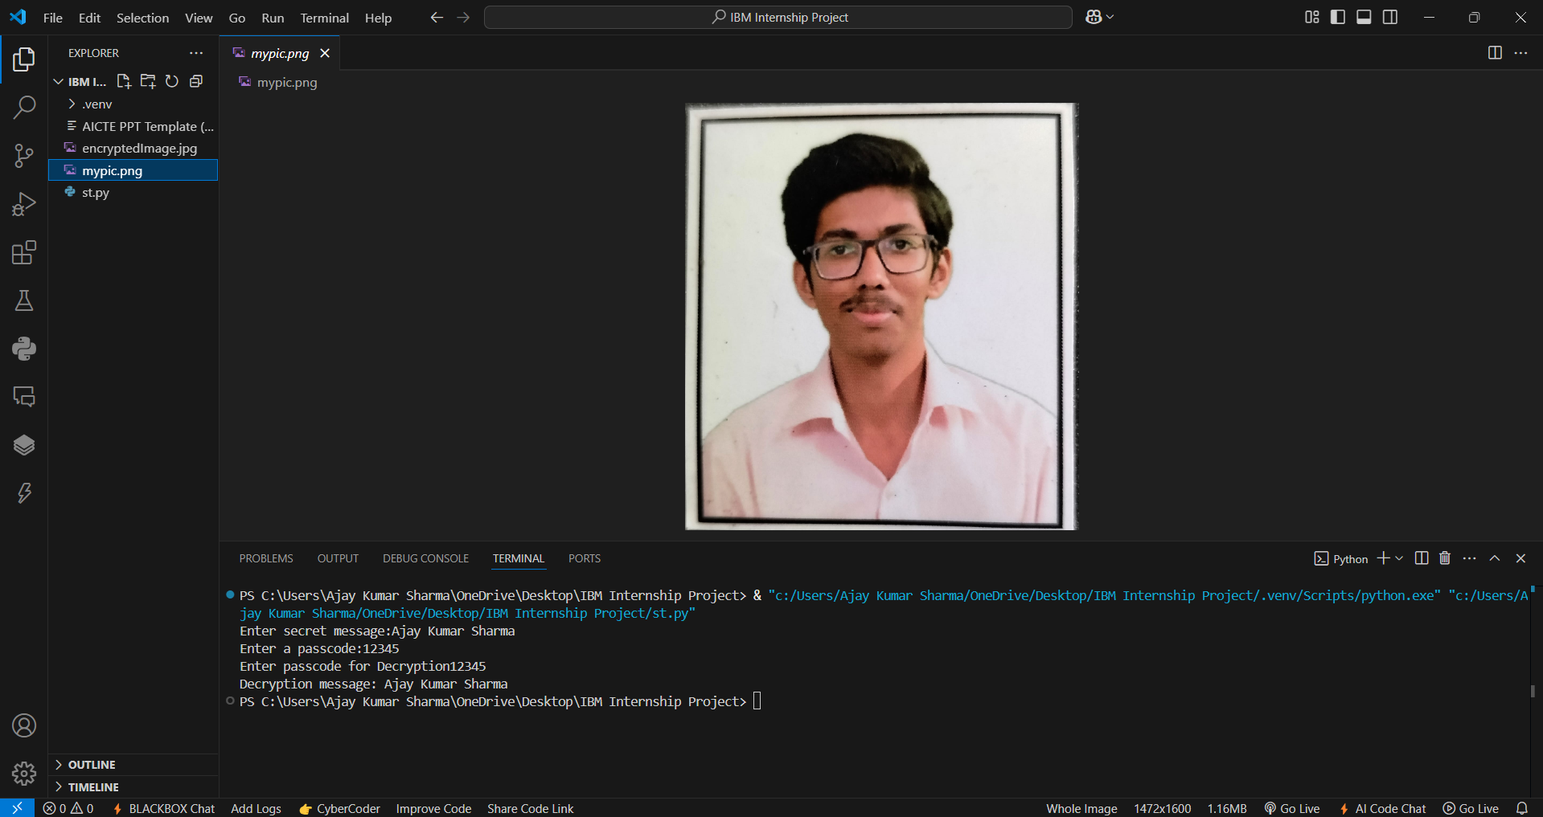
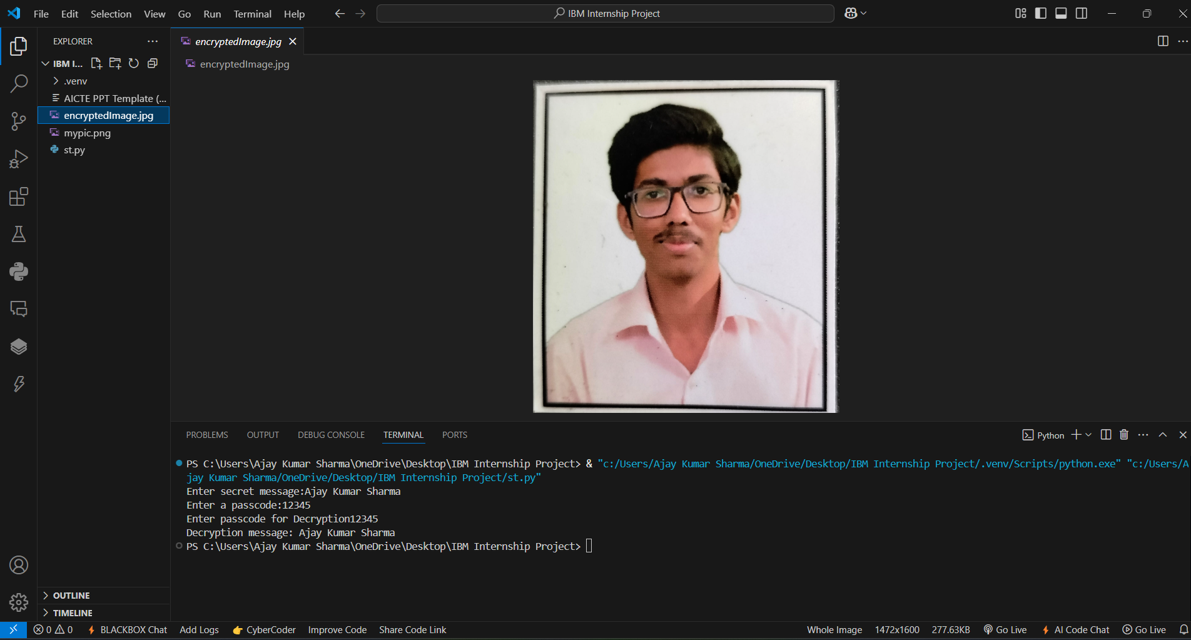
Results
Additional Screenshots for Better Understanding -
1 Original Image (mypic.png) – The main image before
embedding any hidden data.
2 Encrypted Image – The modified image that securely stores
the hidden message and password while appearing unchanged
to the human eye.

Slide 9
Conclusion
1. Steganography is a powerful technique for securely hiding sensitive data within images, ensuring confidentiality without drawing attention.
2. Unlike traditional encryption, it provides covert communication, making data transmission more secure and less detectable.
3. This project successfully implements image-based steganography using Python, allowing users to embed and extract hidden messages securely with a passcode.
4. The system ensures minimal image distortion, lightweight execution, and secure access control, making it ideal for cybersecurity, defense, and private messaging.
5. Future advancements could integrate AI for adaptive encoding techniques, enhancing security and efficiency.

Slide 10
GitHub Link
https://github.com/Ethan-Winters-28/Secure-data-hiding-in-image-using-steganography.git
If First Link Is Not Clickable Then here is Other link Of GitHub
( https://github.com/Ethan-Winters-28/Secure-data-hiding-in-image-using-steganography.git )

Slide 11
Future scope(optional)
AI-Powered Steganography - Implementing machine learning to optimize data hiding techniques for enhanced security and efficiency.
Integration with Cryptography - Combining encryption with steganography for double-layered security, making data extraction even harder.
Steganography in Messaging Apps - Developing a mobile app for secure text/image-based hidden communication.
Adaptive Steganography - Using deep learning to intelligently modify embedding patterns, making detection nearly impossible.
Cloud-Based Secure Storage - Implementing steganography in cloud services to store sensitive data without raising suspicion.
Forensic & Cybersecurity Applications - Enhancing digital watermarking and anti-piracy measures using steganographic techniques.

Slide 12
THANK YOU

